Slide 1
Excel Data analysis Basic

Slide 2
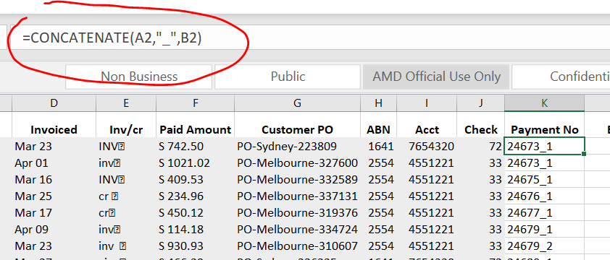
Concatenate function (joins text together)
Concatenate 2 cell strings with “_”:

Slide 3
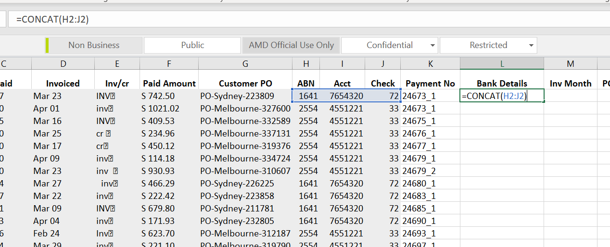
Concat Operator (concatenate djacent elements)

Slide 4
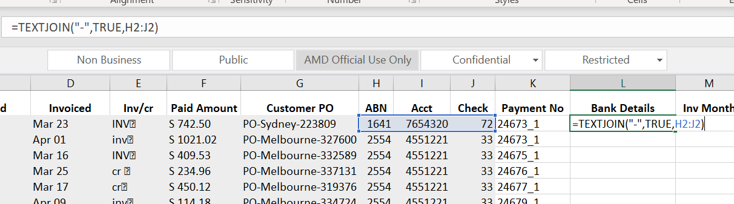
TEXTJOIN (advanced options in combing cells)
“True” means ignore the cell if it empty. The results will be 1641-7654320-72

Slide 5
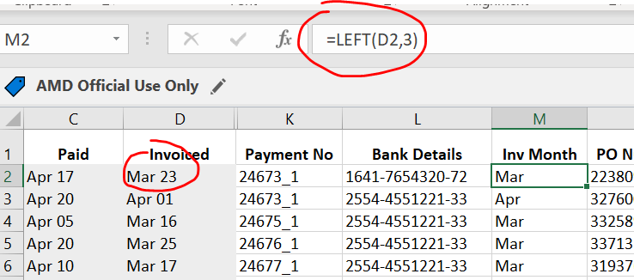
LEFT(Returns the leftmost characters from a text value)
It only work if the target is text format not date format

Slide 6
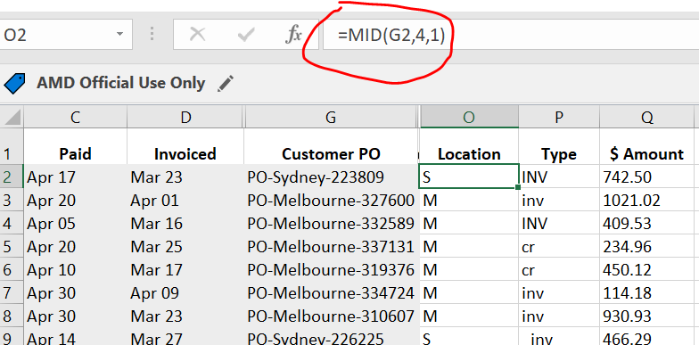
MID(returns a specific number of characters starting at a specifiedposition)
Start position from cell G2,
How many characters we want to get

Slide 7
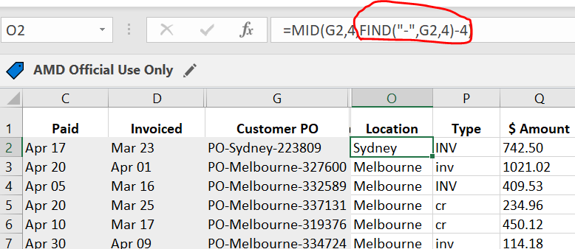
Find (find one text value within another text value)
The purpose of it is to find the position of the second hyphen
4 means it start from position 4 (so that to skip the first hyphen)
Need to minus 4 because we only need “Sydney” which is 6 characters.

Slide 8
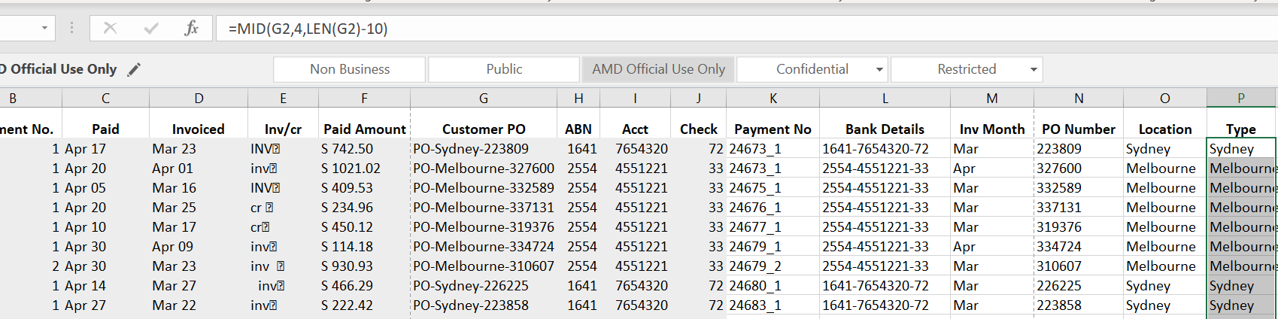
LEN (Return the number of characters in a text string)

Slide 9
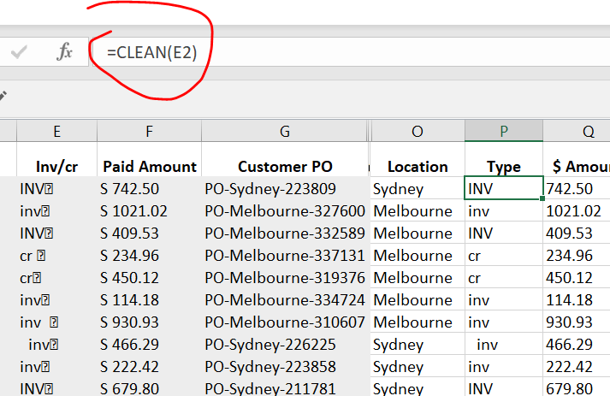
Clean (strips non-printable characters from text)

Slide 10
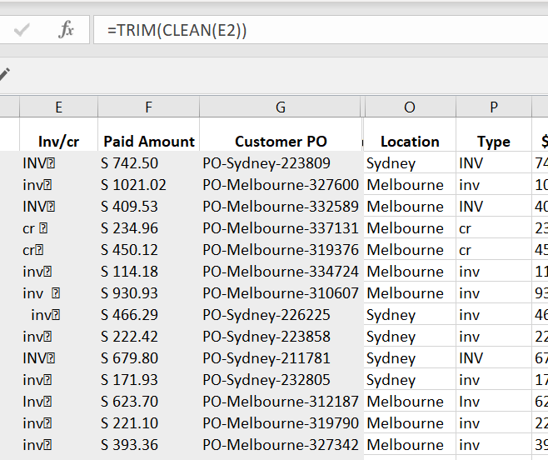
Trim (removes extra spaces from text)
Trim : Remove leading, trailing and extra mid spaces

Slide 11
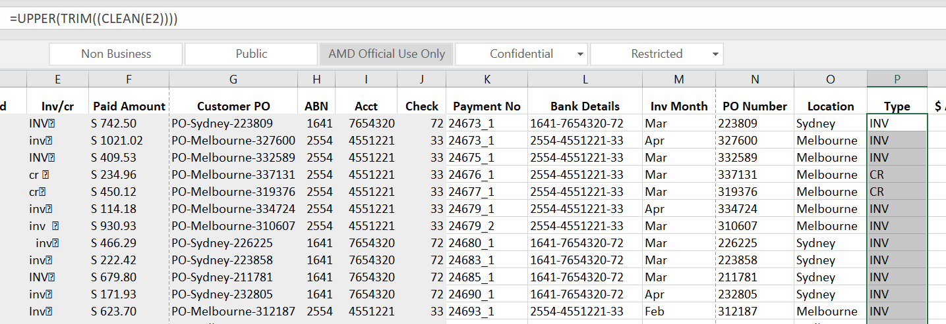
Change case
UPPER
LOWER
PROPER(Capitalizes only the first letter of each word)

Slide 12
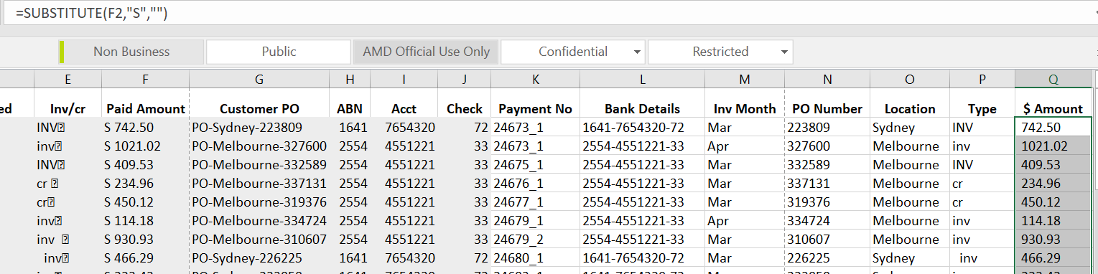
Substitute
Replace text based on content
Replace the S in cell

Slide 13
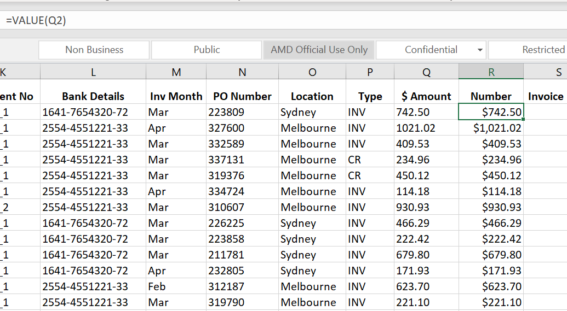
Value (convert text to a numerical value)
Need to convert to value first before we can do arithmetic operations (add, sub,etc). Otherwise, if the value are text, we can’t do the operations

Slide 14
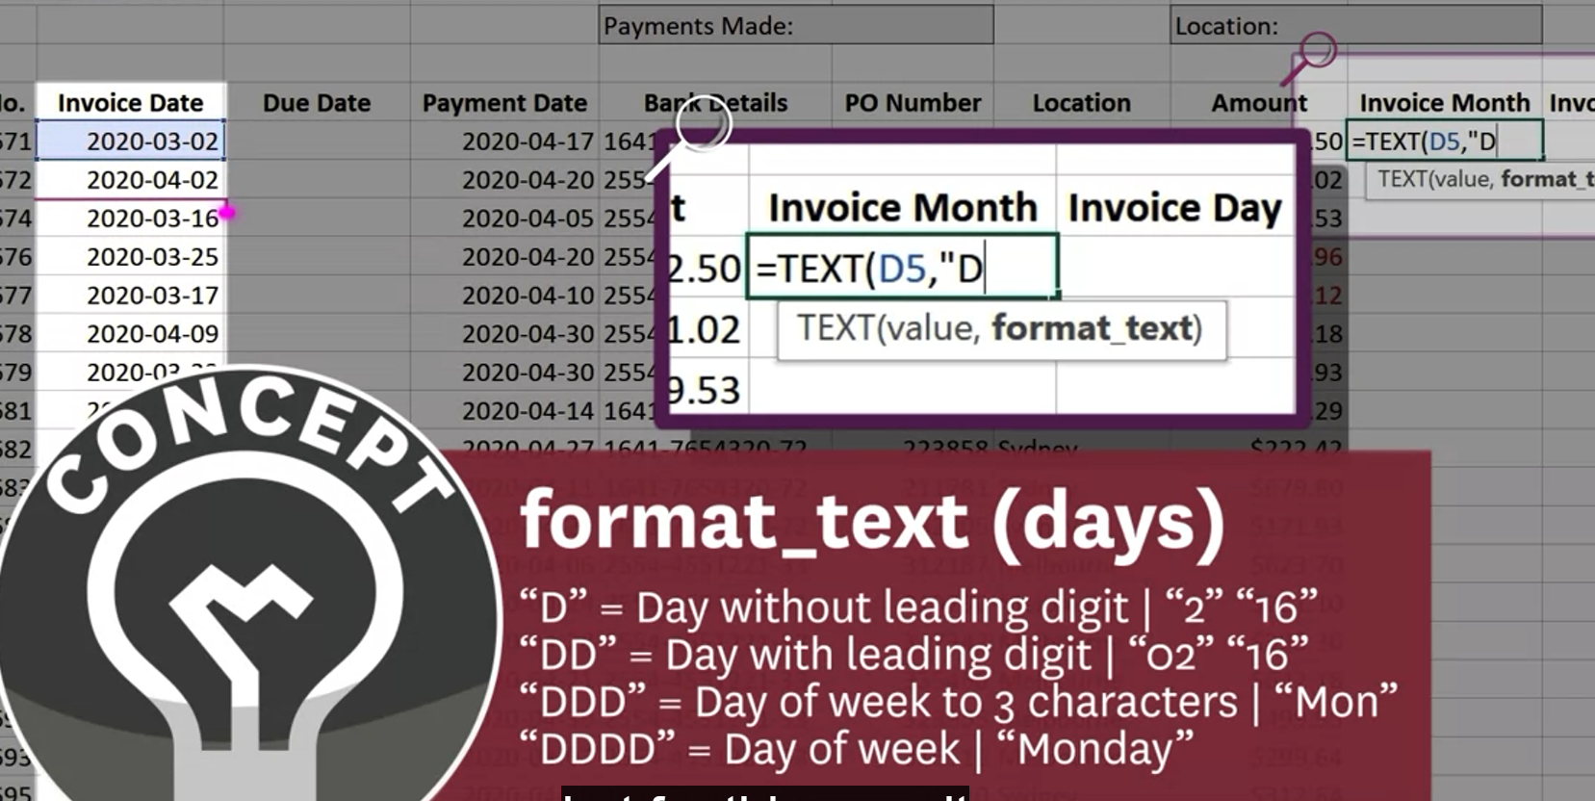
Text(convert and return date as plain text)

Slide 15
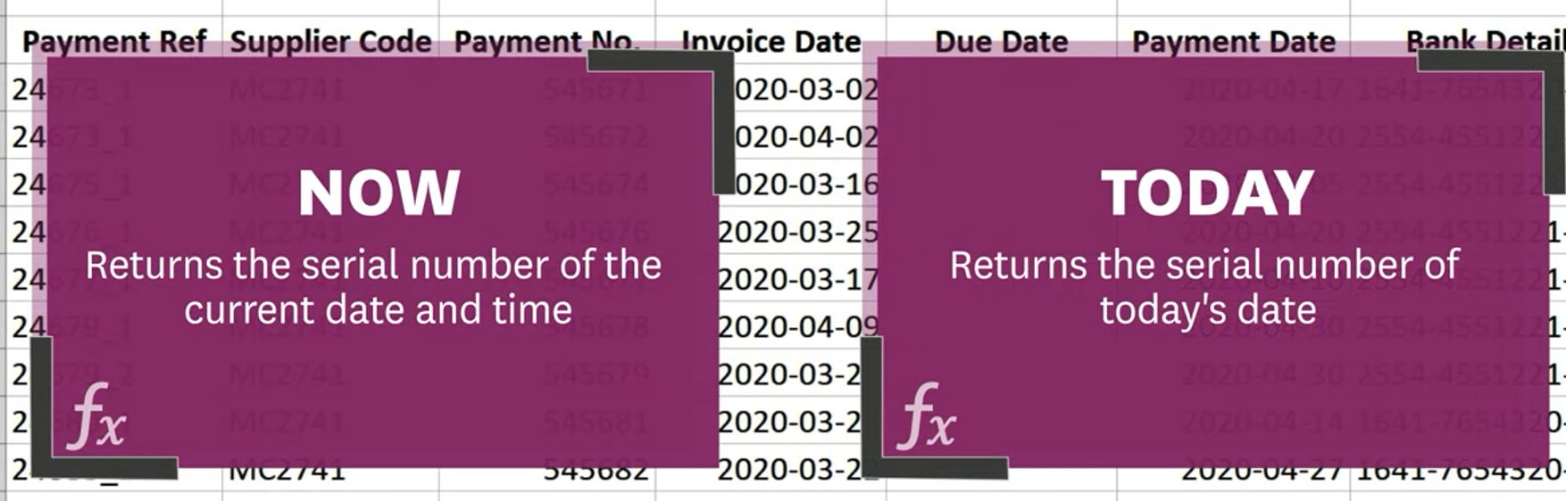
Now & TODAY function

Slide 16
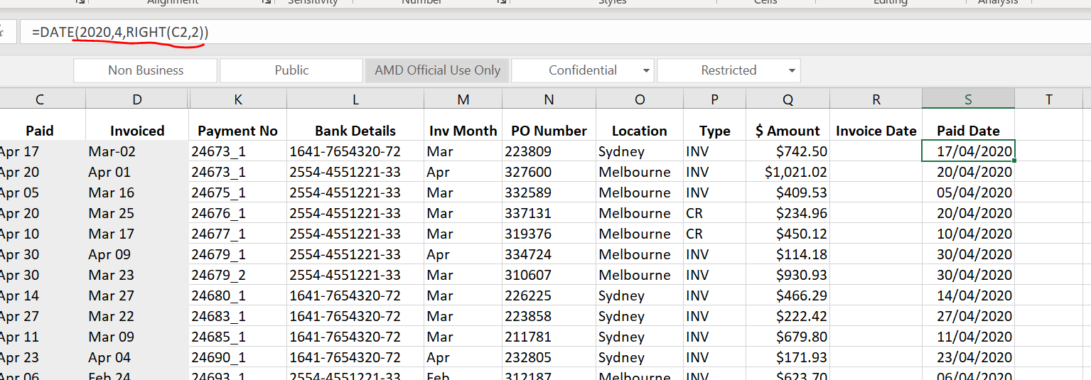
Date (convert text to date)
Must be all numbers
Extract C2 date information

Slide 17
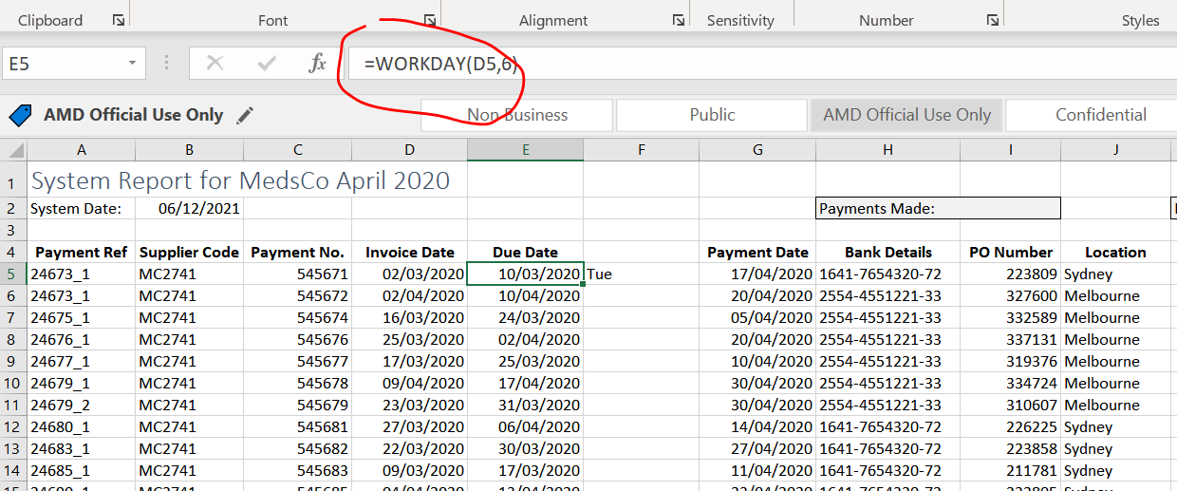
WORKDAY
6 working days after particular date (assume sat/sun are non-working days)

Slide 18
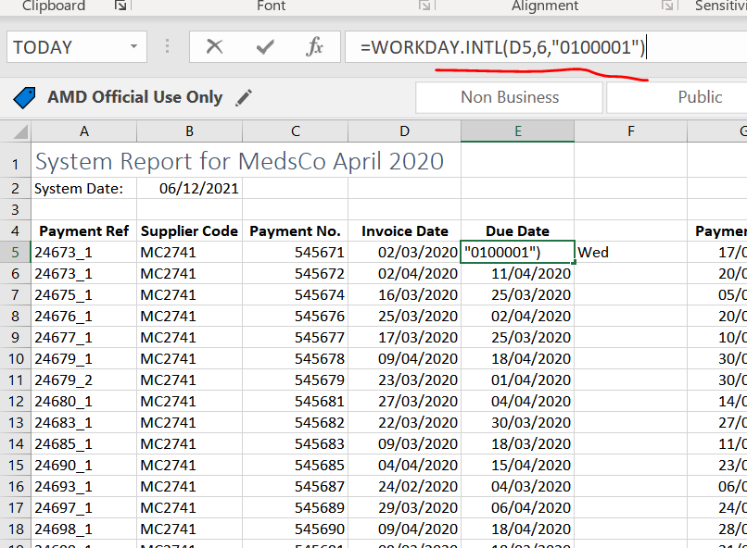
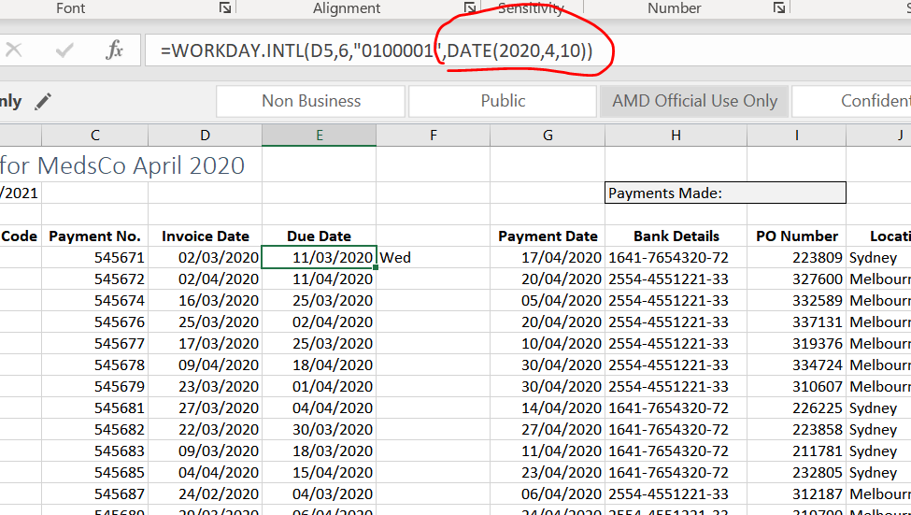
Workday.intl
6 workdays after (assume Tue/Sun are non-working days, so put “1”, the rest days put “0”)
If we want to take into a account of holiday(eg, April 10)

Slide 19
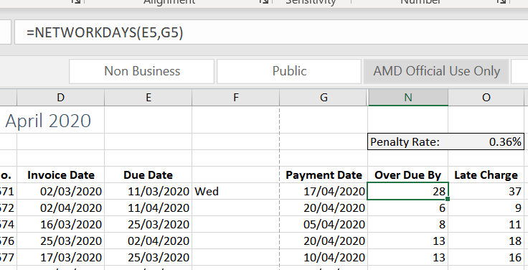
Networkdays (return the number of whole working days between a start/end date)
Assume sat/sun holiday

Slide 20
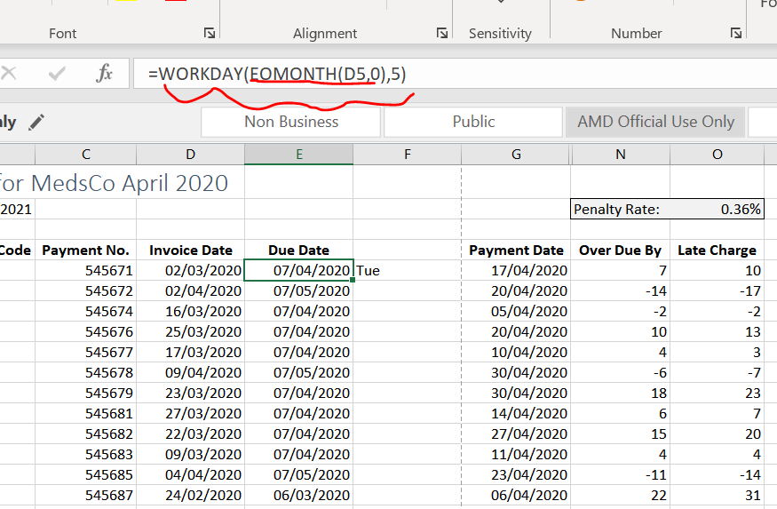
EOMONTH(date of last day of particular month)
If it’s “0”, it will output date of last day of this month. If it’s “1”, it will output date of last day of next month
5 days after last day of this month

Slide 21
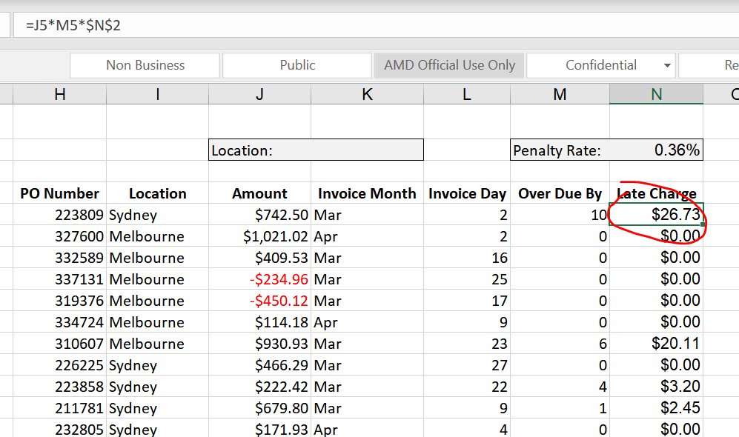
Absolute Referencing (A cell reference that always fixed )

Slide 22
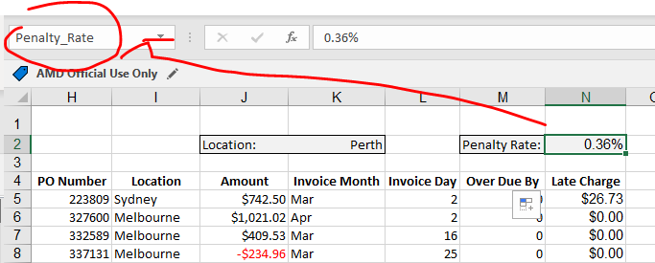
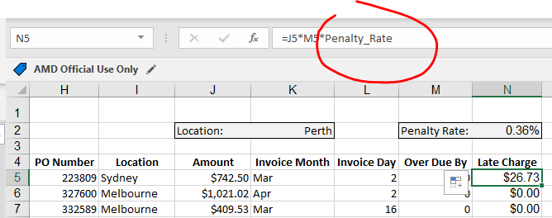
Name Range
Rename it for later usage
By default, it becomes absolute value (no need to put dollar sign )

Slide 23
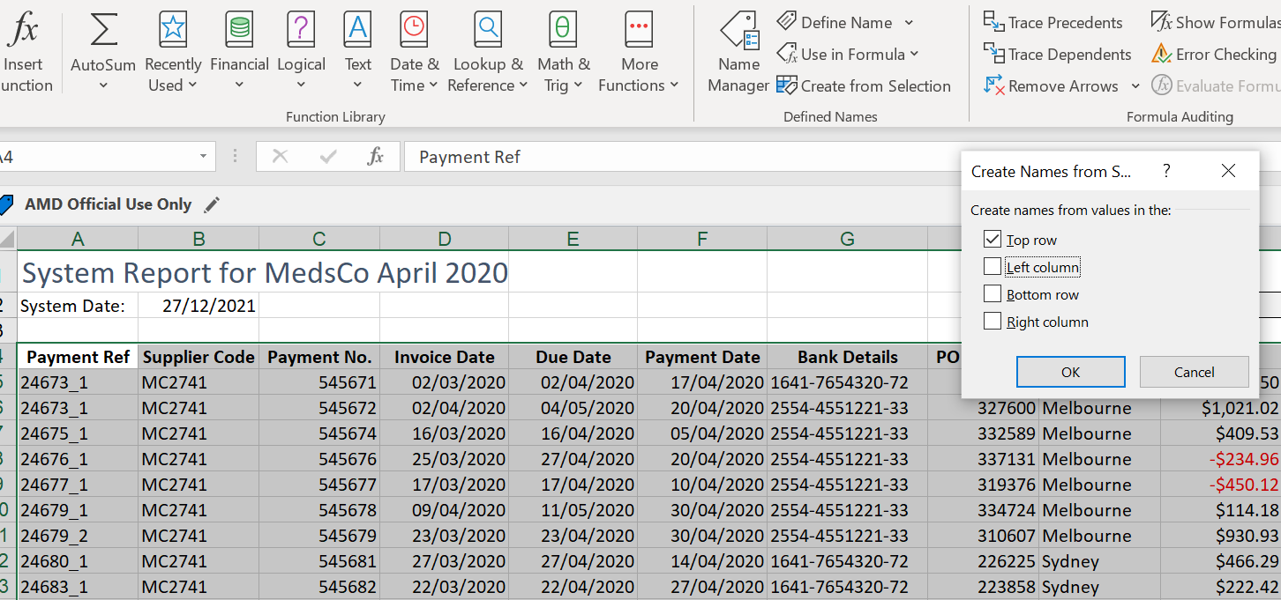
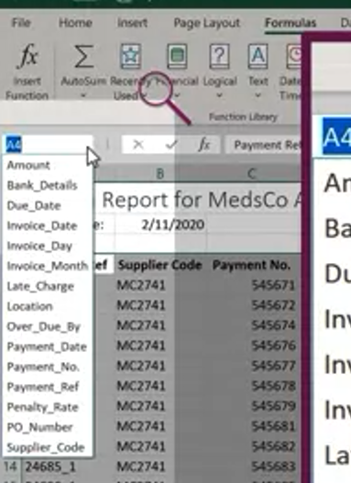
Ways of define name range
Select all data
Select ‘create from selection’
Only tick “Top row” and don’t tick “Left colum” because we don’t want to name the rows
Name ranges will be all added and aviable to use

Slide 24
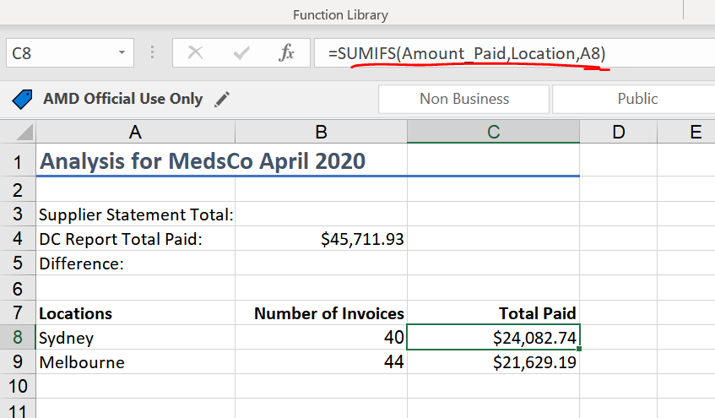
SUMIFS(Sums cells that match multiple criteria)
Search name range which has name “Location”(search the location column)
Looking for the word “Sydney”

Slide 25
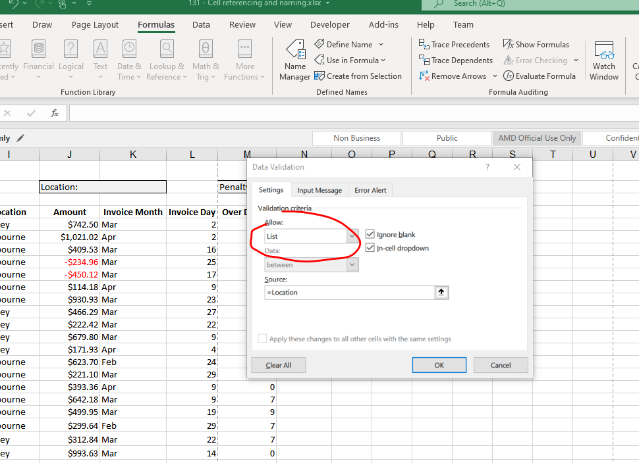
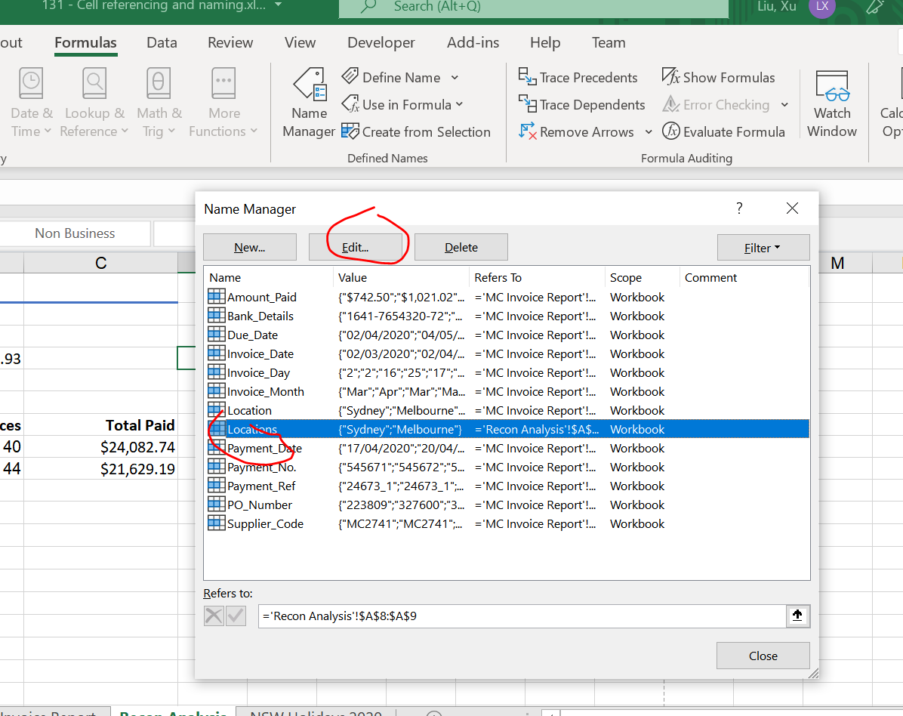
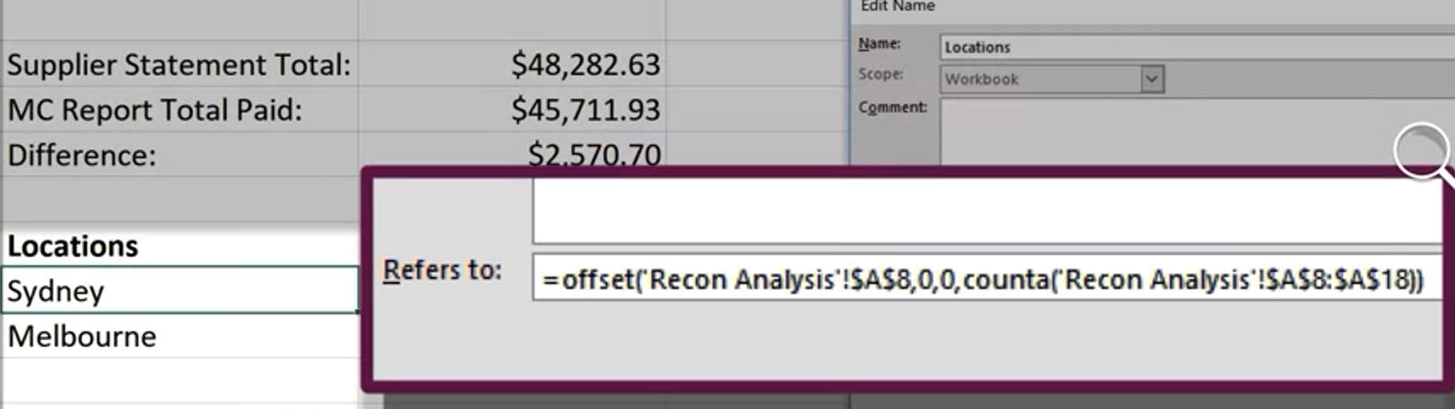
Data Validation (Drop down )
Select cell and click “DATA”- > “DATA VALIDATION”
To make the drop down list dynamic (when update the locations column, the new name will appear in the drop down list ), we need to edit the name range
Select “List”
Select “Formulas” -> “Use in Formula” . Select “Locations”

Slide 26
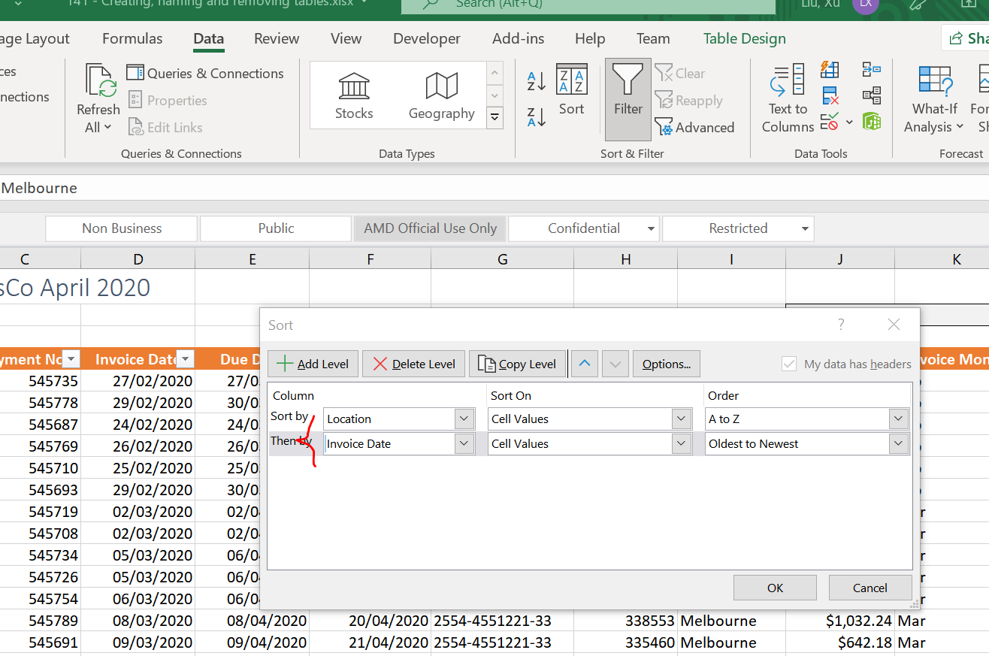
How to sort based on multiple criteria
Select “Data”-> “Sort”
Sort the table base on two criteria “location” & “invoice date”.

Slide 27
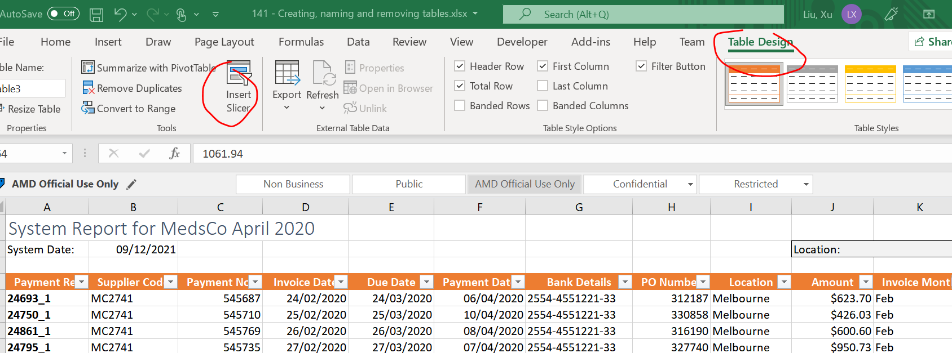
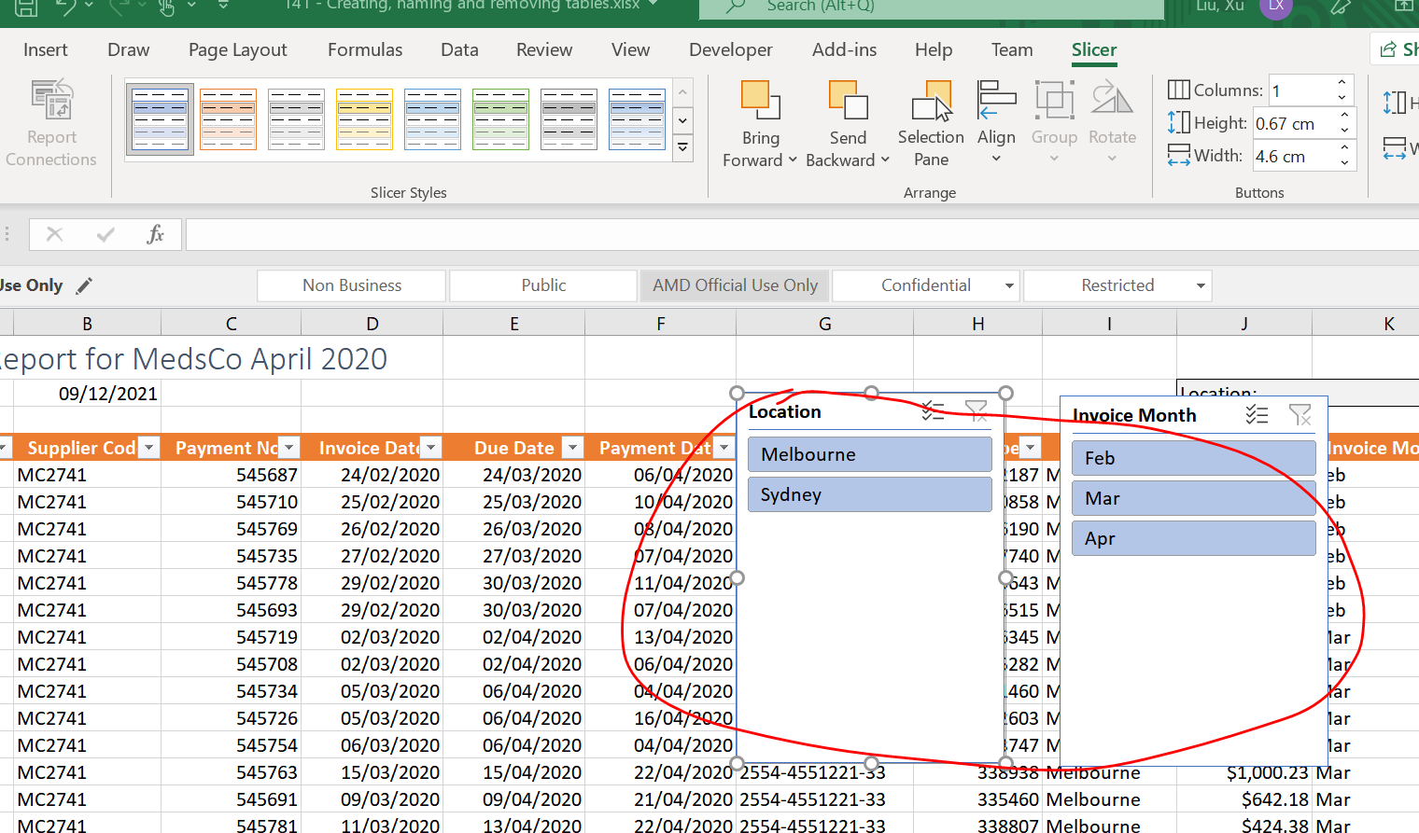
Slicer (visual element used to apply filters to tables)
Click “table design” and select “insert slicer”. 2 slicers been added

Slide 28
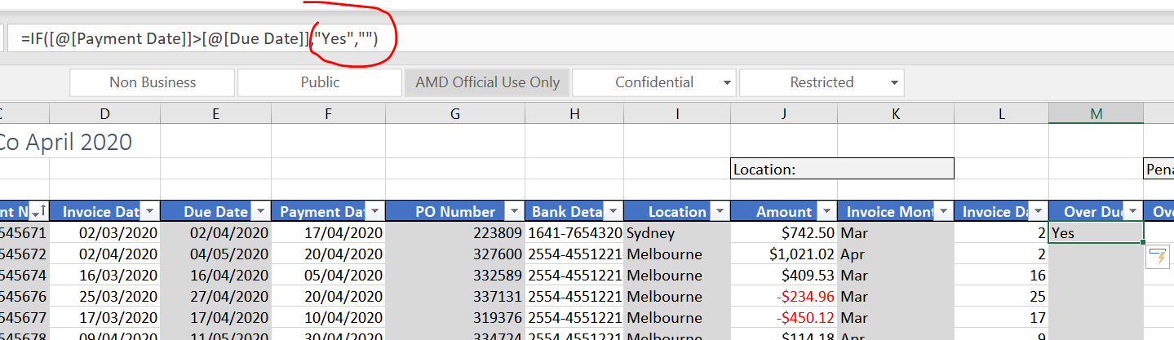
If
If date1 > date2, put a “Yes”. Otherwise, put empty

Slide 29
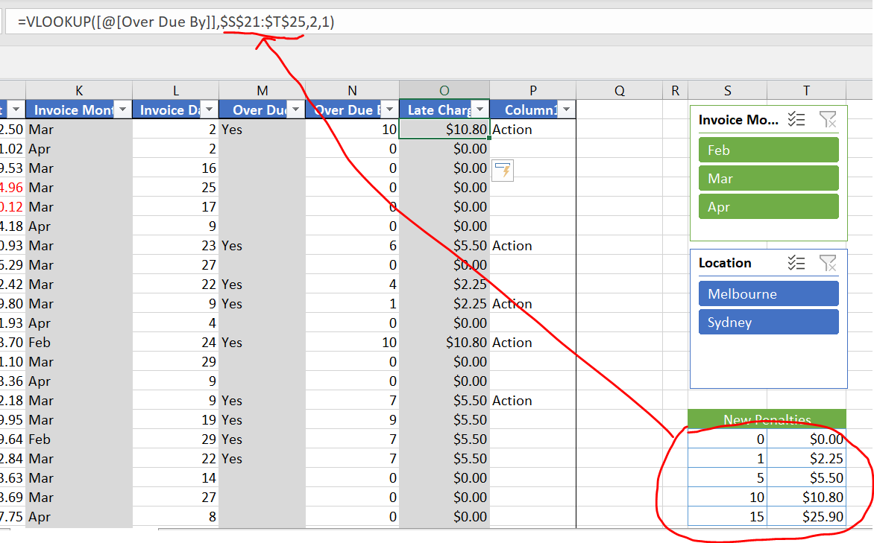
Vlookup (references a vertical table to find and return values)
“1” means range match. E.g. As long as value falls in between 1 5 (eg, 4), the value will be 5.5
“2” means 2nd column of of new Penalties table
Select without choosing the heading (notice the value must arrange from smallest to largest)

Slide 30
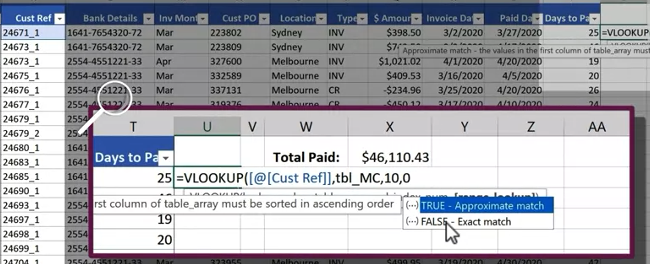
Vlookup match 2 tables
Both table 1 and table 2 have cust refer and amount columns
We want to match table 1 and table 2 (just to validate if the records of amount column on both tables are the same)
10th column of table_mc which is “amount” column
Match with table_mc “cust_ref” column

Slide 31
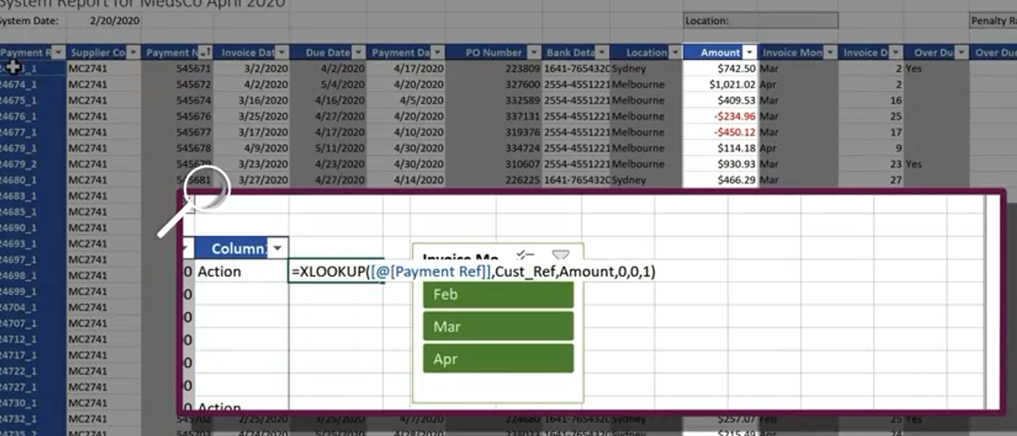
Xlook up match columns
Current table “payment Ref” name range
From another table. “Cust_Ref” name range

Slide 32
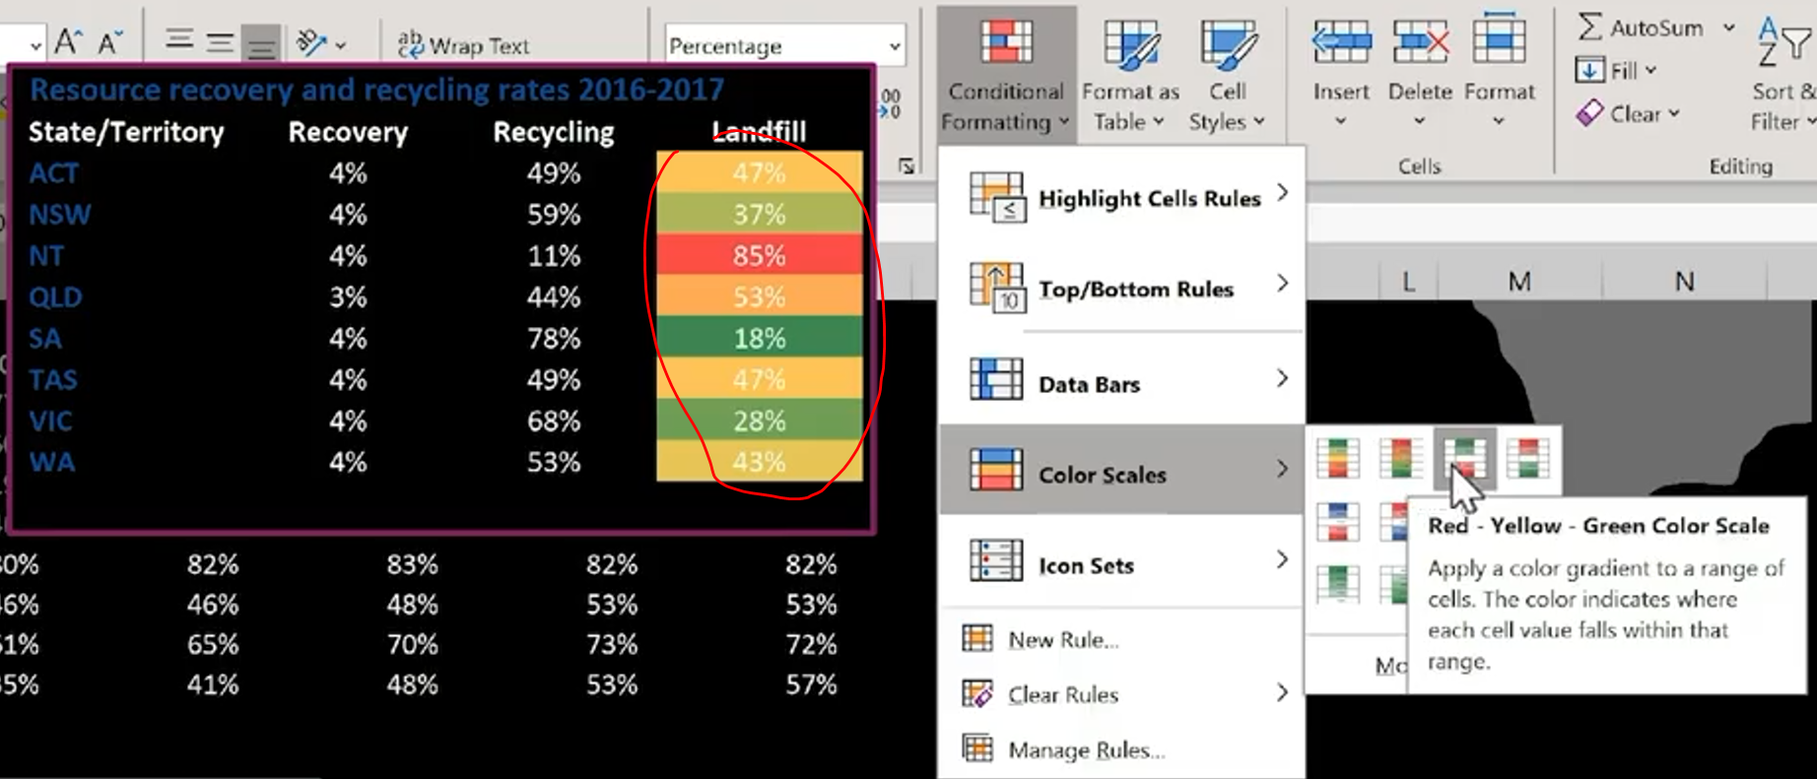
Conditional formatting
Trend formatting:
Select whole range

Slide 33
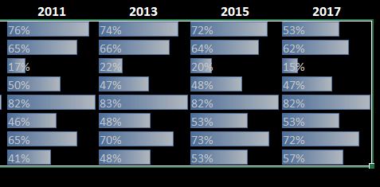
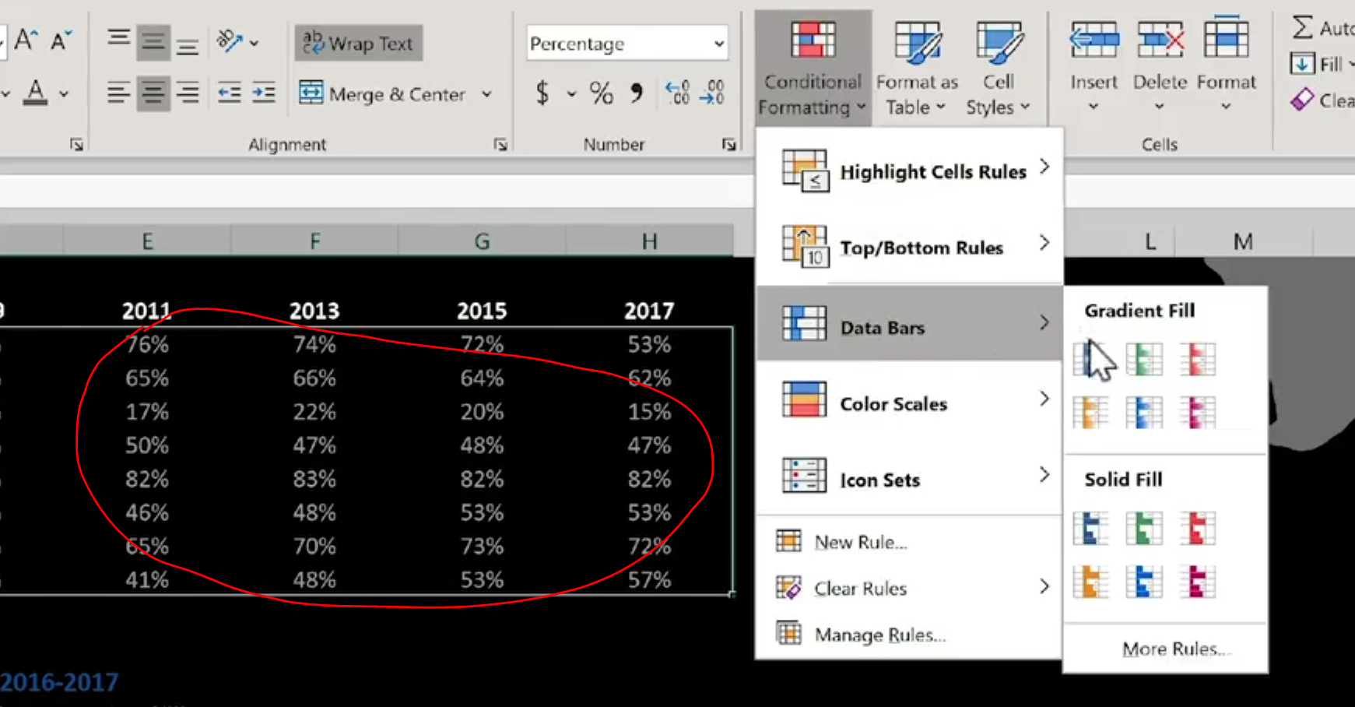
Horizontal bar
Data bar at individual cell:
Horizontal bar at each cell
Select data

Slide 34
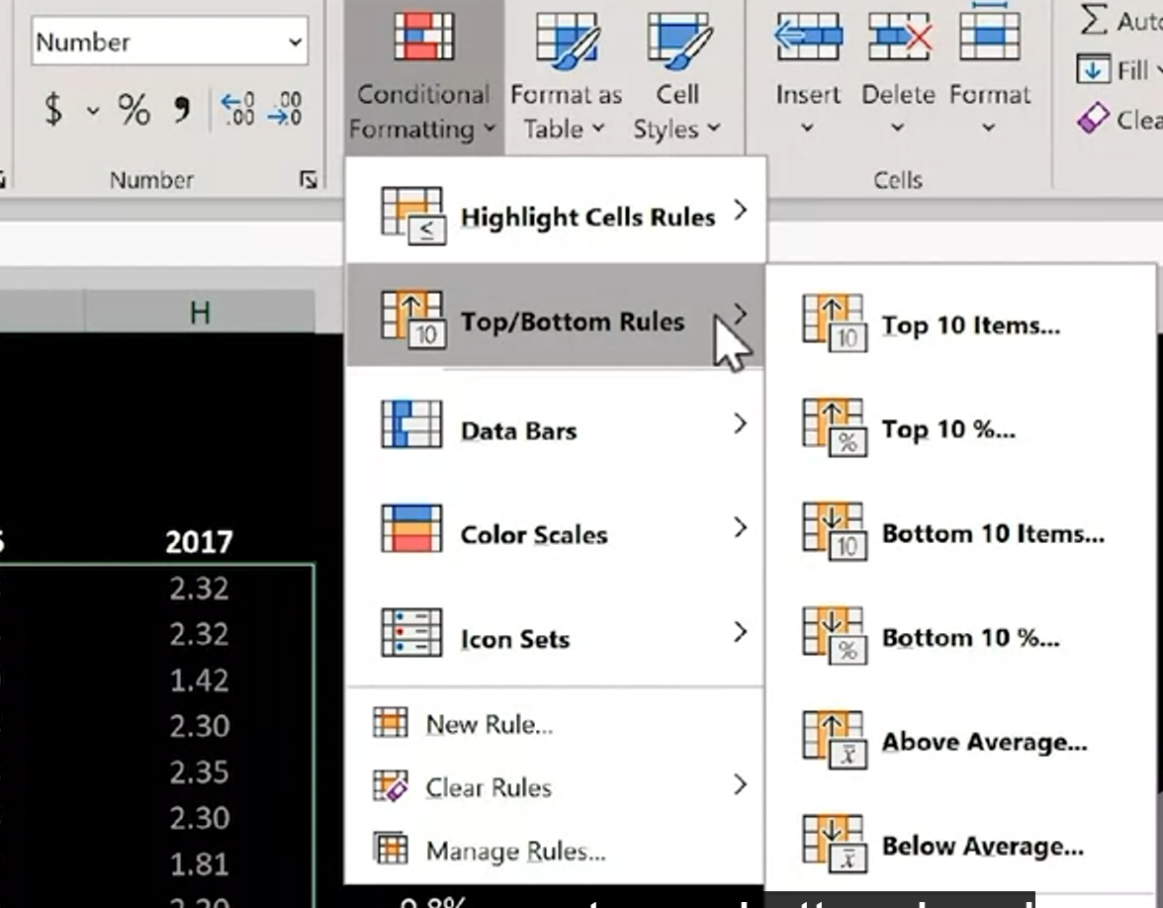
Highlight top/bottom 10
Select & Highlight the top/bottom 10 (or any number) from a group of data:

Slide 35
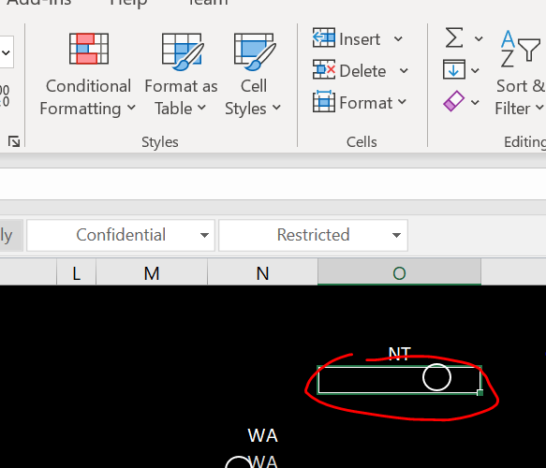
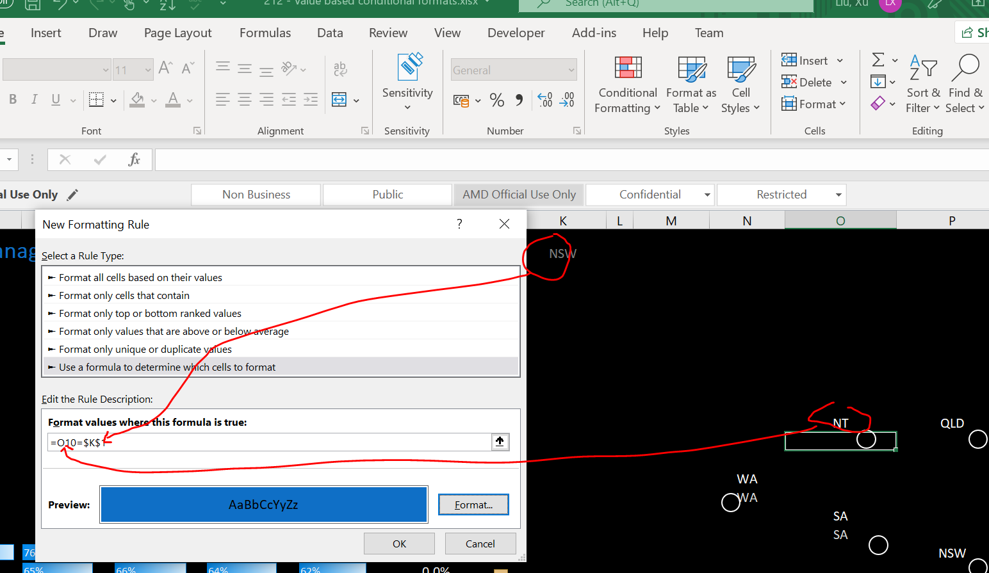
Highlight in the picture
Select drop down option and highlight it in the picture
“Conditional Formatting” -> “New Rule”
Select cell where the circle located
Don’t forget to select the fill in color

Slide 36
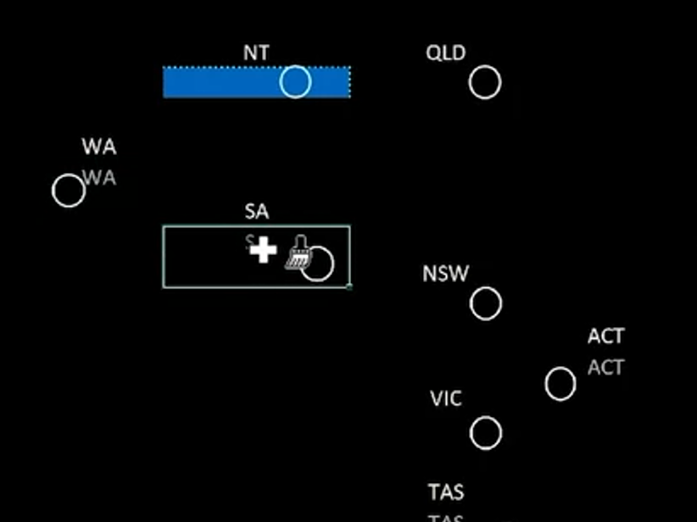
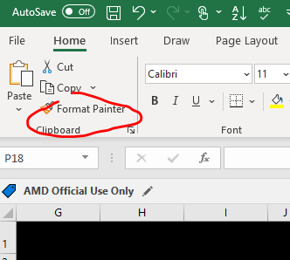
continue
Double click “Format Painter”
Select one by one

Slide 37
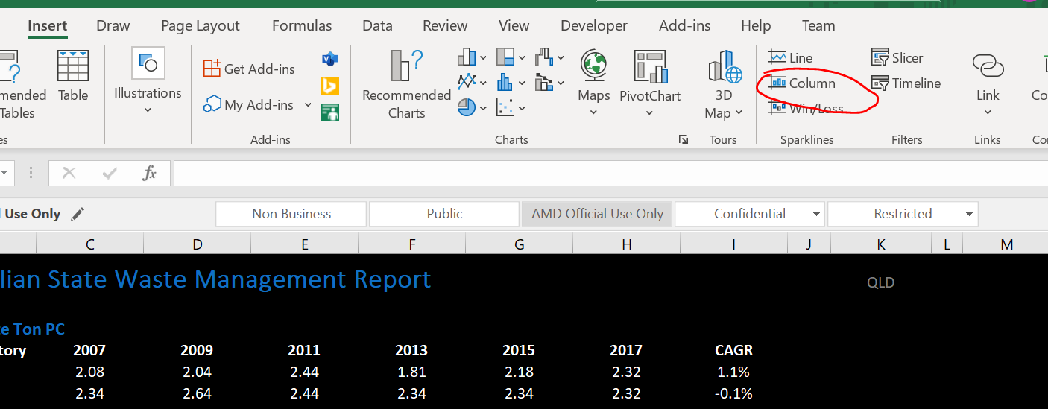
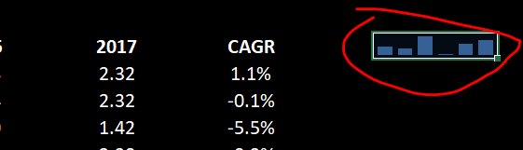
Sparkline (tiny chart in worksheet cell)
Insert-> Column, select range

Slide 38
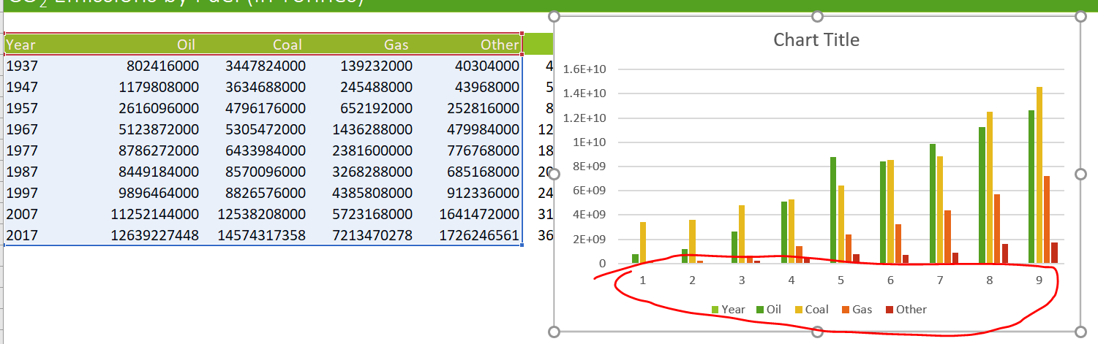
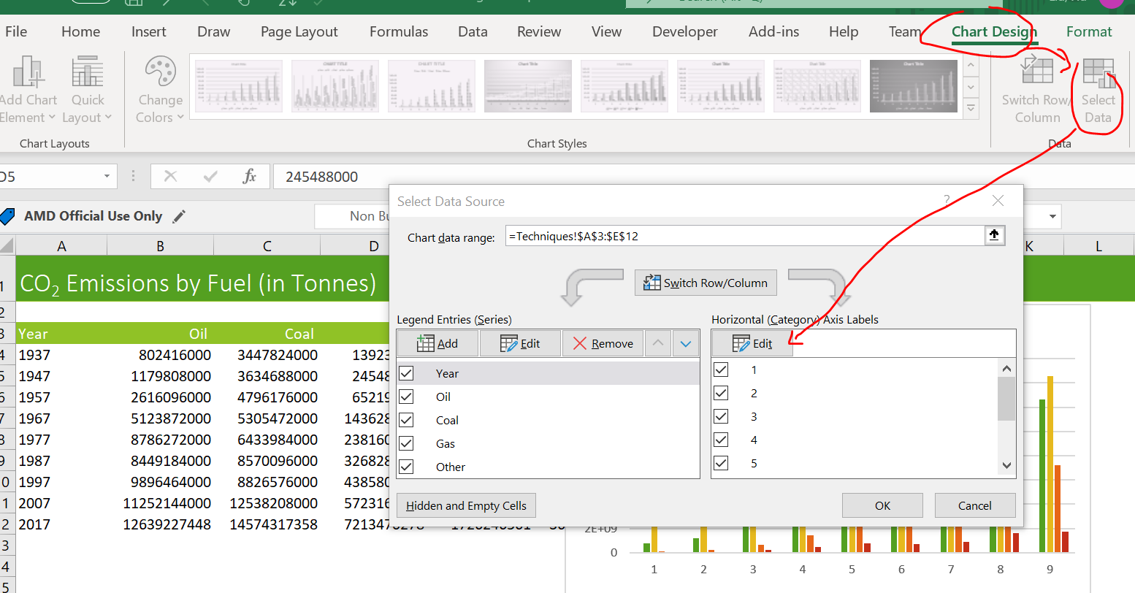
Chart
How to change chart axis
We want to have the x axis as year instead of just 1..9
Select Chart design-> select data-> edit and select year range

Slide 39
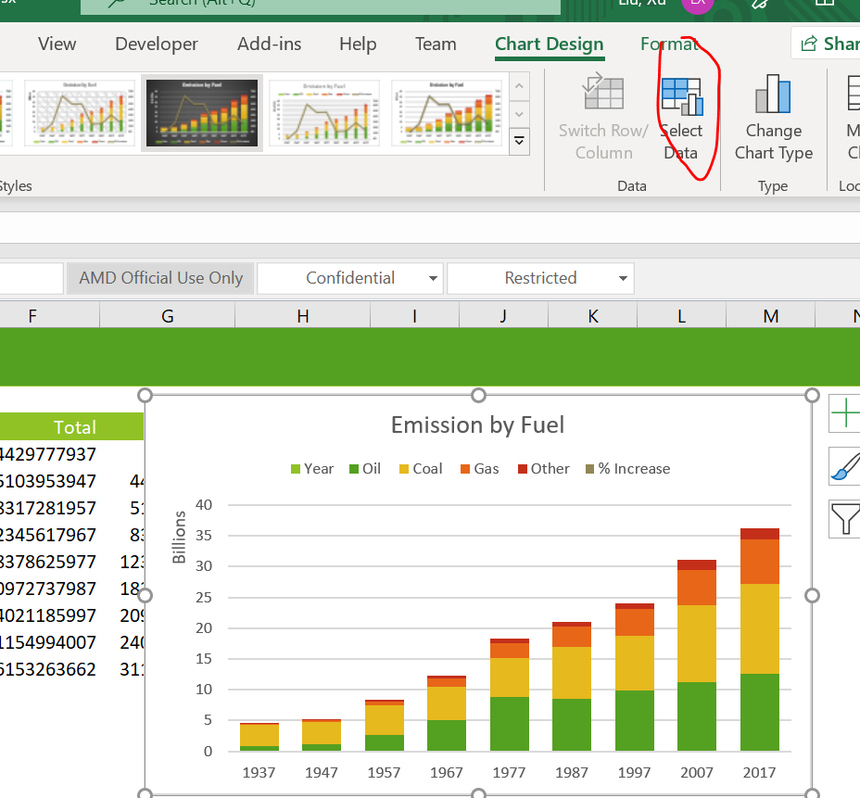
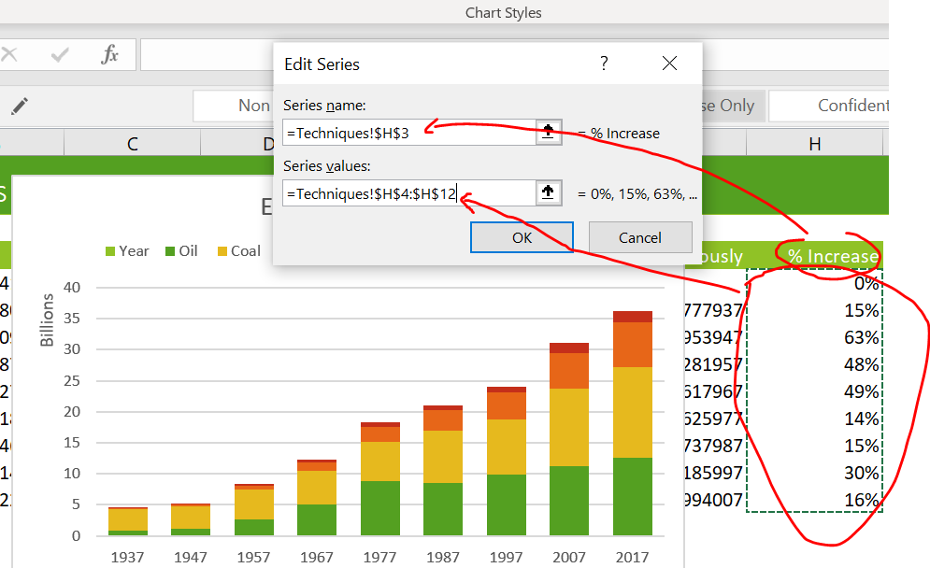


Chart (add line chart to column chart)

Slide 40


Pie charts and doughnuts
To change design layout

Slide 41




doughnuts
Select column which want to include

Slide 42

Line charts and trendlines
To make character smaller

Slide 43


trendlines
R² approximate to 1 means the equation closer to the chart
Predict next 10 years trend

Slide 44

Scatter & bubble chart
Scatter chart shows the correlation between 2 sets of data:

Slide 45


Bubble chart
What if we want to take into the consideration of population as well?
Click “change chart type”
Select bubble chart
Click “select data”
Click edit

Slide 46

Bubble chart continue…
Select population as the bubble size reference

Slide 47


Sunburst chart for hierarchical data
Hierarchical data(data been suvdivided into subcategories)
E.g. Top 10 greenhouse gas countries and each country subdivided in to different sector

Slide 48

Custom chart & animation with Macro
Dropdown list
The reason why female change to negative because we want the female on the negative axis

Slide 49


Continue..

Slide 50


Continue

Slide 51


Continue
Type 0;0;0
Click “Add”

Slide 52


Continue

Slide 53


Continue

Slide 54


Pivot table
Recommendation is to change the data to table first before create pivot table

Slide 55


Continue…
Non- Numeric value
Numeric value
To turn on/off Pivot Table Fields

Slide 56


Dashboard (planning and layout an effective dashboard)
1) Can only create until column s (need to aware)
2) Change theme color

Slide 57


Continue…
3) Select area and
select shape
4) Select and drag the tile

Slide 58


Continue…
5) Shape fill black
6) No outline

Slide 59


Continue…
7) Can put icon as well
8) To move the chart : select chart and click “Move Chart” Under Design tab
9) Select the worksheet you want to insert to

Slide 60


continue
Create map data: put cursor in the dataset and select “Filled Map” under Insert tab map

Slide 61

Continue.
Click “nofill”

Slide 62



Continue (responsive infographics)
Create sparkline
Copy and paste the newly created sparkline to dashboard (‘copy linked picture’ so that if the original chart change, the dashboard will follow the change as well)

Slide 63


continue
To use slicer (slicer needs to link pivot chart)
Select “Insert Timeline” under “pivotChart Analyze”

Slide 64


continue
They share the same dataset, so we can select all of them

Slide 65
Power query
Tool to import from different resources and clean it up into excel format
Example of pull data from pdf to excel

Slide 66


1)
2)

Slide 67


3)
4)
Select “transform data”
Update table 2,3 heading same as table 1

Slide 68


5)
6)

Slide 69


7)
8)

Slide 70


9) Right click and select “Load to…”
10)

Slide 71



Merge query

